Slide 1




ایران دلکو در اندیشه آسمانی آبی...
Timeline for whole set of U5 plus Main catalytic converter and Exhaust System
Apr-21-2025

Slide 2
Table of Contents
Contents
Input Data
Technical Specification & Supplier
Alternative solution
Planning
Contacts

Slide 3
1-Input data

Slide 4
Input data
Document Name | Version
2D U5 plus Rear Catalytic Converter | A00079193_DWG
2D U5 plus Middle Muffler | A00059476_DWG
2D U5 plus End Muffler | A00108775_DWG
3D Model of U5 plus Rear Catalytic Converter | A00079193_002
3D Model of U5 plus Middle Muffler | A00059476_005
3D Model of U5 plus End Muffler | A00108775_002
Specification Of Requirements | SOR-C40D-14040110-006-D C40D-v SOR-C40D-C03-172024-0005 C40D-C03-e SOR-C40D-F09-2020-00009678-merge

Slide 5
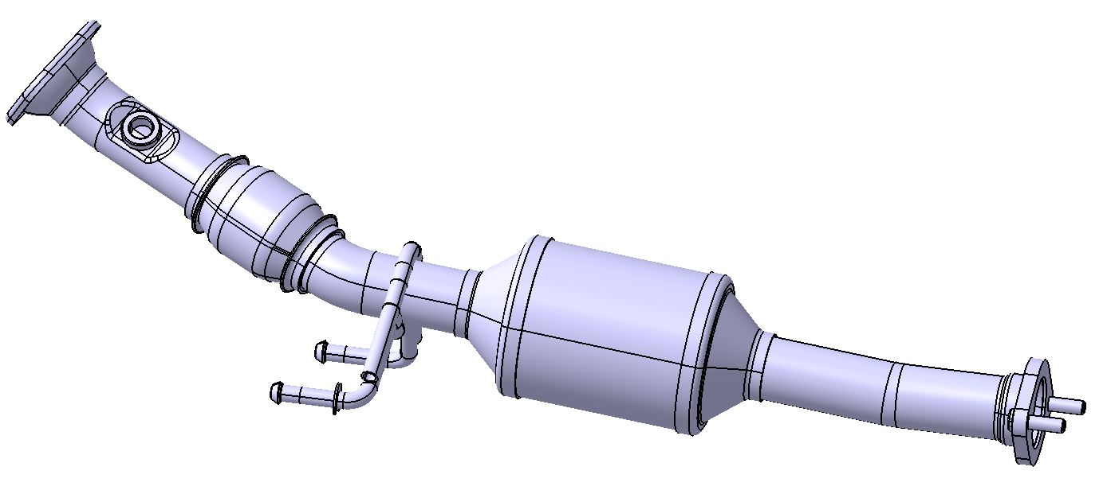
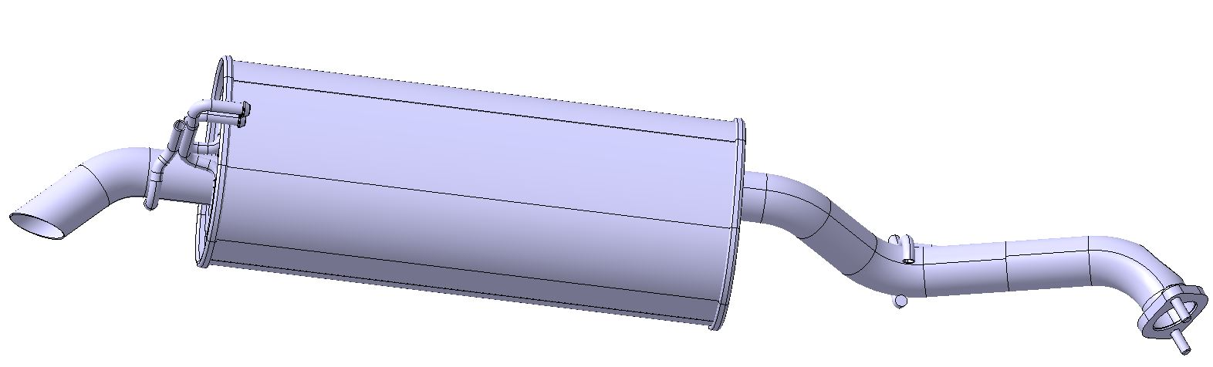
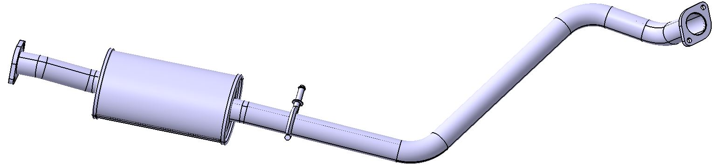
Product
Pictures of the Products
Rear Catalytic Converter
Middle Muffler
End Muffler
Notes:
Macro-description of the product with its Reserve (argumentation + alternative solution).
(explosion drawing or disassemble picture of the RFQ should be shown here)

Slide 6
2-Technical Specification & Supplier

Slide 7
2-1-Rear Catalyst

Slide 8
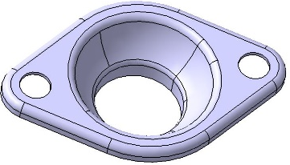
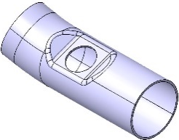
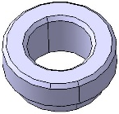
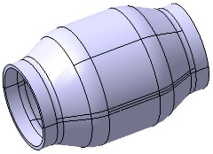
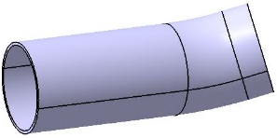
Technical Specification (BOM)
Item | Part name | Material according to customer's drawing | Inventory status | IDCO’s Suggestion | Picture
1 | Inlet Flange | SUS441,T=2mm | Available in Iran Delco | -------
 |  | En10088-2
2 | Inlet Pipe | SUH 409L, ⌀45x1.5 | Available in Iran Delco | -------
 |  | En10088-2
3 | Sensor Boss | SUS304 | Available in Iran Delco | -------
 |  | En10088-2
4 | Flexible | ⌀45.3x100‐SUS 321 | Available in Iran Delco | -------
 |  | En10088-2
5 | Middle Pipe | SUH 409L, ⌀45x1.5 | Available in Iran Delco | -------
 |  | En10088-2

Slide 9
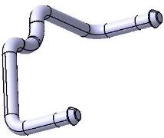
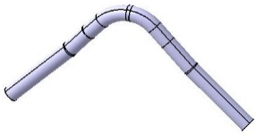
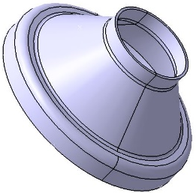
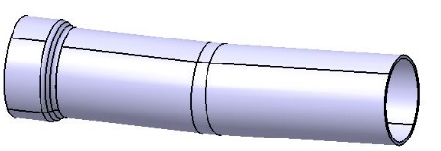
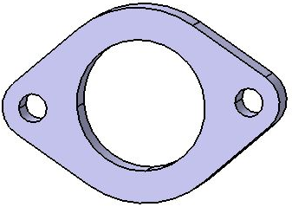
Technical Specification (BOM)
Item | Part name | Material according to customer's drawing | Inventory status | IDCO’s Suggestion | Picture
6 | Hunger1 | SUH409L,⌀12,T=1.5mm | Not available in Iran Delco and local market | *ST37-2,⌀12
 |  | En10088-2
7 | Hunger 2 | Q235A,⌀12 | Available in Iran Delco | -------
 |  | DIN17100
8 | Inlet Cone | SUS441,T=1.5mm | Not available in Iran Delco and local market | **SUS409L,T=1.5mm
 |  | En10088-2
9 | Outlet Cone | SUS409,T=1.5mm | Available in Iran Delco | -------
 |  | En10088-2
10 | Outlet Pipe | SUH 409L, ⌀45x1.5 | Available in Iran Delco | -------
 |  | En10088-2
11 | Outlet Flange | Q235B | Available in Iran Delco | ------
 |  | DIN17100
**According to Alternative solution -1(Slide 21)

Slide 10
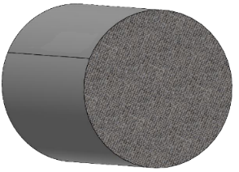

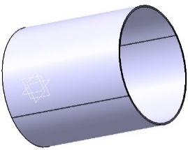
Technical Specification (BOM)
Item | Part name | Material according to customer's drawing | Inventory status | IDCO’s Suggestion | Picture
12 | Monolith | Φ101.6x123.3 400CPSI/(4 or 6.5)Mil | Not available in Iran Delco and local market | Φ101.6x123.3 400CPSI/6Mil
13 | Mat | 3M 100 4070 | Not available in Iran Delco and local market | Unifrax-ccmax1600gr/m²
14 | Shell | SUH409L,T=1.2mm | Available in Iran Delco | -------
 |  | EN10088-2

Slide 11
2-2-Middle Muffler

Slide 12
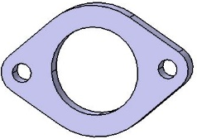
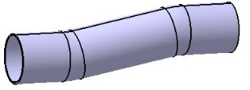
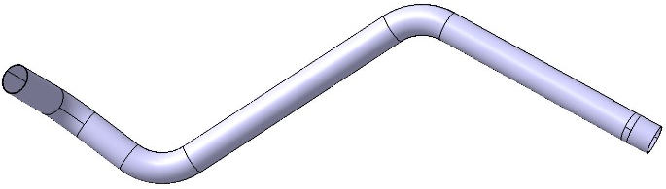
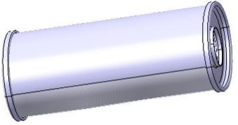
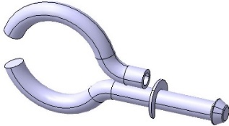
Technical Specification (BOM)
Item | Part name | Material according to customer's drawing | Inventory status | IDCO’s Suggestion | Picture
1 | Inlet & Outlet flange | Q235B | Available in Iran Delco | ------
 |  | DIN17100
2 | Inlet Pipe | SUH 409L, ⌀50x1.2 | Not available in Iran Delco and local market | *SUS 409L, ⌀50x1.5
 |  | En10088-2
3 | Outlet Pipe | SUH 409L, ⌀50x1.2 | Not available in Iran Delco and local market | *SUS 409L, ⌀50x1.5
 |  | En10088-2
5 | Exterior shell | SUS439,T=??? | Not available in Iran Delco and local market | *SUS409,T=0.6mm
 | Interior shell | En10088-2
6 | Hanger 1 | SUH409L,⌀12,T=1.5mm | Not available in Iran Delco and local market | *ST37-2,⌀12
7 | Hanger 2 | Q235A, ⌀12,T=1.5mm | Not available in Iran Delco and local market | *ST37-2,⌀12
*According to Alternative solution -2 (Slide 23)
*According to Alternative solution -2 (Slide 23)
*According to Alternative solution -1 (Slide 22)
***According to Alternative solution -2 (Slide 23)

Slide 13
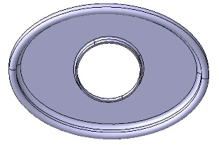
Technical Specification (BOM)
Item | Part name | Material according to customer's drawing | Inventory status | IDCO’s Suggestion | Picture
8 | Inlet & Outlet Caps | SUS439,T=??? Thickness are not Available | Not available in Iran Delco and local market | *SUS409,T=1.5mm
 |  | En10088-2
Note :The specifications inside the Muffler , including Baffles and Perforated tubes are not Available

Slide 14
2-3-End Muffler

Slide 15

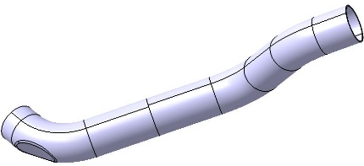
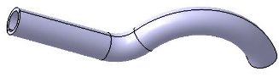
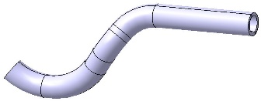
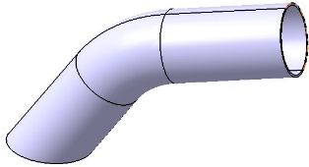
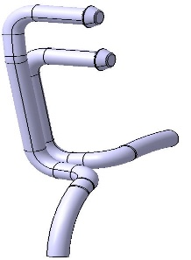
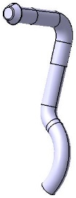
Technical Specification (BOM)
Item | Part name | Material according to customer's drawing | Inventory status | IDCO’s Suggestion | Picture
1 | Inlet Flange | Q235A,T=10mm | Available in Iran Delco | ------
 |  | DIN17100
2 | Inlet Pipe | SUH 409L, ⌀50x1.2 | Not available in Iran Delco and local market | *SUS 409L, ⌀50x1.5
 |  | En10088-2
3 | Hanger 1 | SUH409L,⌀12,T=1.5mm | Not available in Iran Delco and local market | *ST37-2,⌀12
 | Hanger 2
5 | Outlet Pipe | SUH 409L, ⌀50x1.2 | Not available in Iran Delco and local market | *SUS 409L, ⌀50x1.5
 |  | En10088-2
6 | Hanger 3 | Q235A, ⌀12,T=1.5mm | Not available in Iran Delco and local market | *ST37-2,⌀12
7 | Hanger 4

Slide 16
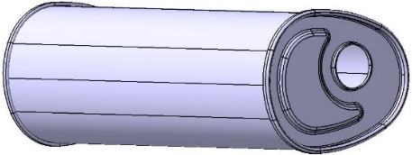
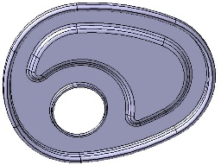
Technical Specification (BOM)
Item | Part name | Material according to customer's drawing | Inventory status | IDCO’s Suggestion | Picture
8 | Exterior shell | SUS439,T=??? Thickness are not Available | Not available in Iran Delco and local market | *SUS409L,T=0.6mm
 | Interior shell | En10088-2
 |  |  |  | *SUS409L,T=0.4mm
9 | Inlet and outlet Caps | SUS439,T=??? | Not available in Iran Delco and local market | *SUS409L,T=1.2mm
 |  | En10088-2
Note :The specifications inside the Muffler , including Baffles and Perforated tubes, are not Available

Slide 17
3- Alternative solution

Slide 18
Alternative solution
Alternative solution -1
SUS441,T=1.5mm
1-Inlet Cone (Rear Catalyst)
2D&3D | IDCO ‘s Suggestion (Alternative)
SUS 441,T=1.5mm | SUS 409L,T=1.5mm

Slide 19
Alternative solution
Alternative solution -1
SUS439,T=???mm
2D&3D | IDCO ‘s Suggestion (Alternative)
SUH 439,T=??mm | SUS 409L,T=0.4mm SUS 409L,T=0.6mm SUS 409L,T=1.2mm SUS 409L,T=1.5mm
1-Exterior and Interior shells for middle and End Muffler
2- Inlet and Outlet Caps
Thickness are not Available

Slide 20
Alternative solution
Alternative solution -2
Pipe (SUH409L,⌀12,T=1.5mm)
Pipe (SUH409L,⌀50,T=1.2mm)
Pipe (Q235A, ⌀12,T=1.5mm)
1-Hanger1 (Rear Catalyst)
2-Hanger 1 (Middle Muffler)
3-Hanger 1&2 (End Muffler )
1-Hangers (End and Front Muffler
And main catalyst)
1-Inlet & outlet Pipes(Middle Muffler)
2-Inlet & outlet Pipes(End Muffler)
2D&3D | IDCO ‘s Suggestion (Alternative)
SUH409L,⌀12,T=1.5mm | ST37-2,⌀12
2D&3D | IDCO ‘s Suggestion (Alternative)
SUH409L,⌀50,T=1.2mm | SUH409L,⌀50,T=1.5mm
2D&3D | IDCO ‘s Suggestion (Alternative)
Q235A, ⌀12,T=1.5mm | Q235A, ⌀12

Slide 21
Alternative solution
Alternative solution -3
The suggested specifications of Substrate & Support Mat is as follows :
Part name | IDCO ‘s Suggestion
Support Mat (Rear Catalyst) | Non Intumescent 4HP Unifrax CCMAX 1600 g/m²
Monolith (Rear Catalyst) | Φ101.6x123.3 400CPSI/6Mil
Note : CC-Max 4 HP mat is produced when the proprietary fiber is converted into a flexible felt-like product.
Note :The material is thermally stable and engineered to maintain a controlled holding force on the substrate across a wide temperature range from ambient to 1250°C (inlet gas temperature).

Slide 22
Alternative solution
Alternative solution -4
The suggested specifications of Sensor Boss is as follows :
Item | Part name | IDCO ‘s Suggestion
17 | Sensor Boss | SUS 304, EN10088-2

Slide 23
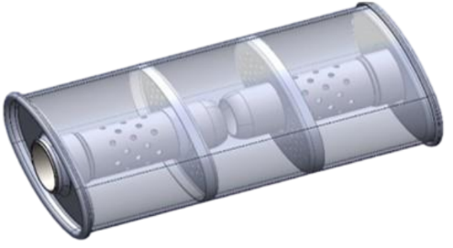
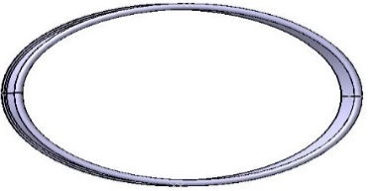
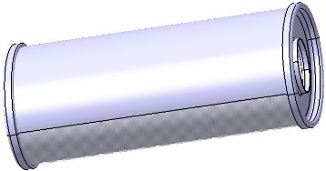
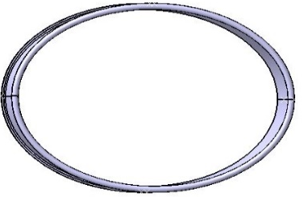
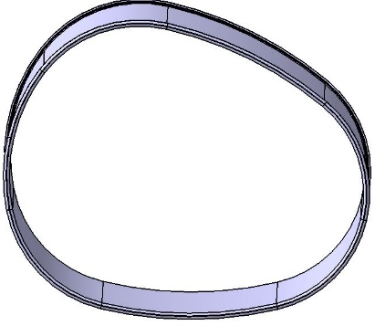
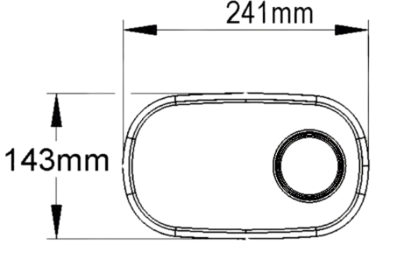
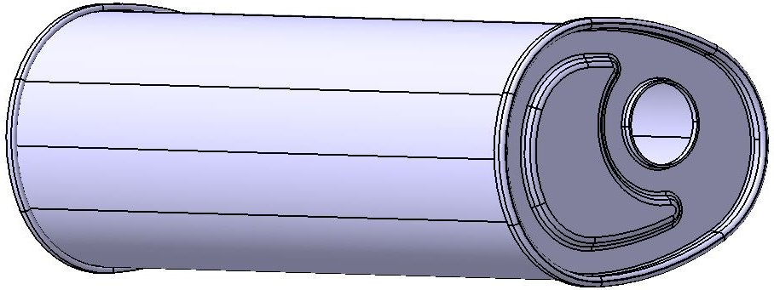
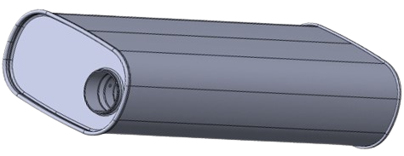
Alternative solution
Alternative solution -5
According to the dimensions of the U5 plus Mufflers and existing Mufflers of Iran Delco, The suggested specifications is as follows :
150mm
299mm
162.4mm
310mm
85mm
117.7mm
207.3mm
526.2mm
163.8mm
655mm

Slide 24
4- Planning

Slide 25



Planning
Catalyst IDCO ‘s Suggestion
Part Name | Off tools Sample | SOP
whole set of U5 plus Main catalytic converter and Exhaust System | 3.5 Months | 4 Months
Starting the Manufacturing Equipment
SOP
Preparation of Proposal
Approval of TA
Preparation of price analysis
Prototype Manufacturing and replacement in CKD
Sending TA results to the Standard Center
Contract with the Supplier
Product definition on the Sina site
The end of manufacturing
checking fixtures
Inquiry from Supplier
M1
M2
M3
M4
Catalyst destruction and extraction
Approval of Emission test
OTS
Contract with the customer
The end of manufacturing
production fixtures
Estimated planning is based on alternative solutions including carry over the Middle and end Mufflers

Slide 26
5- Contacts

Slide 27
Contacts
Catalyst IDCO ‘s Suggestion
Email | Tel | Name | Position | NO
m.molavizadeh@irandelco.com | 09121163927 | Mohammad Molavizedeh | CEO | 1
Coating@irandelco.com | 09127206522 | Nasrin Ebrahimabadi | Coating deputy | 2
Canning@irandelco.com | 09124721376 | Davood Akbari | Canning deputy | 3
Eng@irandelco.com | 09121867368 | Kamran Rangani | Technical and Engineering manger | 4
Kamalzadeh@irandelco.com | 09123955439 | Ladan Kamalzadeh | R&D manger | 5
Ahmadimoghaddam@irandelco.com | 09124600230 | Sara Ahmadimoghaddam | Sales and marketing manager | 6
Rezazadeh@irandelco.com | 09127177836 | Amir Hossein Rezazadeh | Projects Coordinator | 7
Matin@irandelco.com | 09122838095 | Mohammad Matin | Head Of Quality Assurance | 8
20

Slide 28



Technical and engineering department
Apr-2025
Shams Abad Industrial City - Tehran - Iran
Tel: +982156230240
www.Irandelco.com

